Slide 1

EDR100
Electrical Drivelines 1
HT2023
Danyang Cui
Lecture 2

Slide 2
Course outline
Course intro, tools, getting started with simulations
Vehicle behaviors and simulation tricks, drive cycles
Simulation of Electric Machine with MotorCAD data
Simulation of Power Electronics and Battery
Full vehicle behavior, assignments & groups

Slide 3
Lecture 2 outline
Gearbox and differential
Drive cycles
Intro to vehicle model in Simulink
Assignment 2

Slide 4
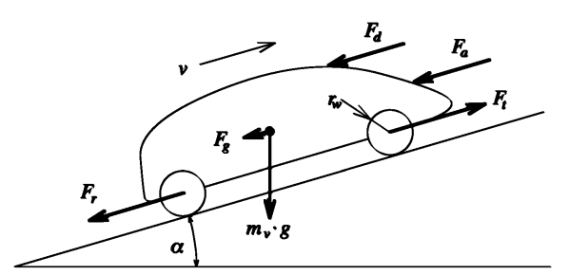
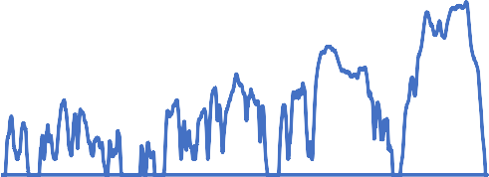
Performance calculations
Vehicle data
Driving behavior
Vehicle model
Performance requirements
160,00
Wheel torque Wheel speed Wheel power
…
vt [km/h]
120,00
𝐹 = 𝑚 ∙ 𝑎
...
80,00
40,00
0,00
0,00
5,00
10,00 15,00
Time [min]
20,00
25,00
30,00

Slide 5
Drive Cycles

Slide 6
Drive cycles
Wikipedia:
“a series of data points representing the speed of a vehicle versus time. Driving cycles are produced by different countries and organizations to assess the performance of vehicles in various ways, as for instance fuel consumption, electric vehicle autonomy and polluting emissions.”
Related/similar: Driving Cycles, Mission Profile
Drive cycles is the condition under which fuel consumption, emissions,
efficiency and electric range are measured.

Slide 7
Drive cycles
What is typically represented in drive cycles?
Speed vs time
Acceleration vs time (optional, can be derived from speed)
Gear selection (in NEDC)
What is not represented
Wind speed
Slopes
Thermal loads (temperature, wind, solar irradiation)

Slide 8
Examples of drive cycles
Examples of official certification cycles for cars
WLTC - Worldwide Harmonised Light Vehicles Test Procedure
NEDC - New European Drive Cycle (1970 – 2019)
US06 – USA
FTP - Federal Test Procedure, USA
HWFET - Highway fuel economy test, USA
NYCC - New York City Cycle, USA
Other
Artemis (Urban, Rural, Highway)

Slide 9
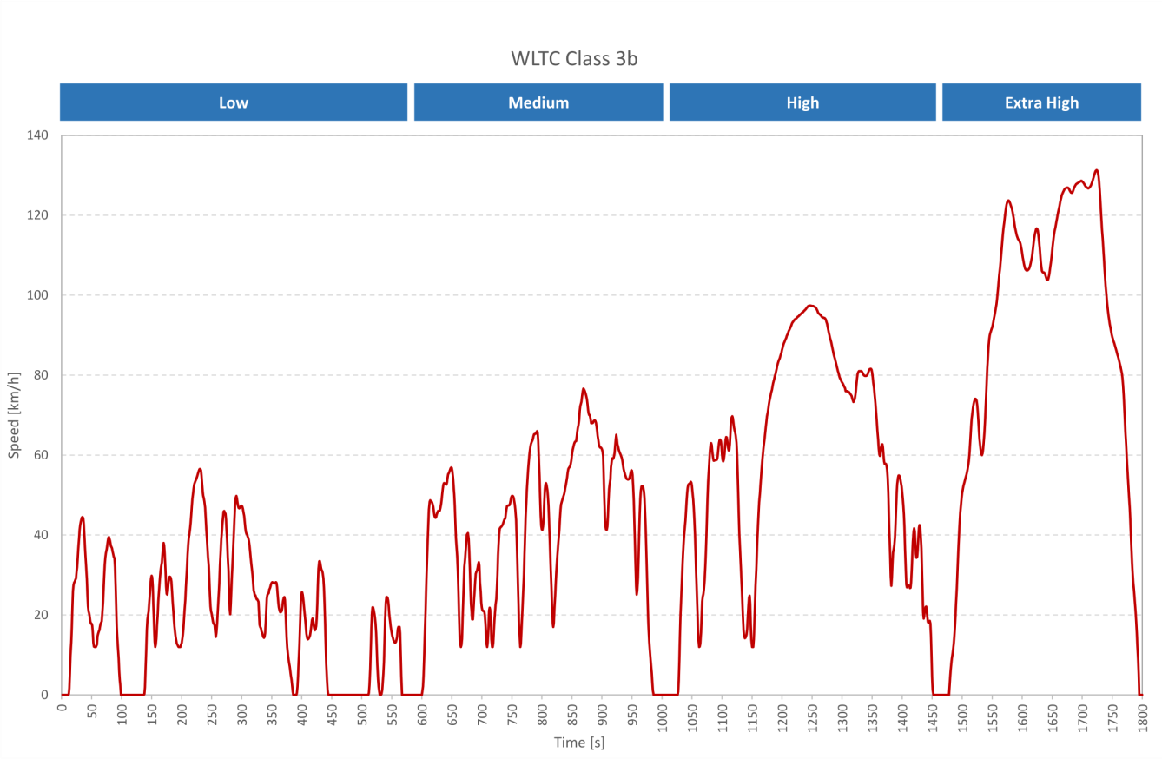
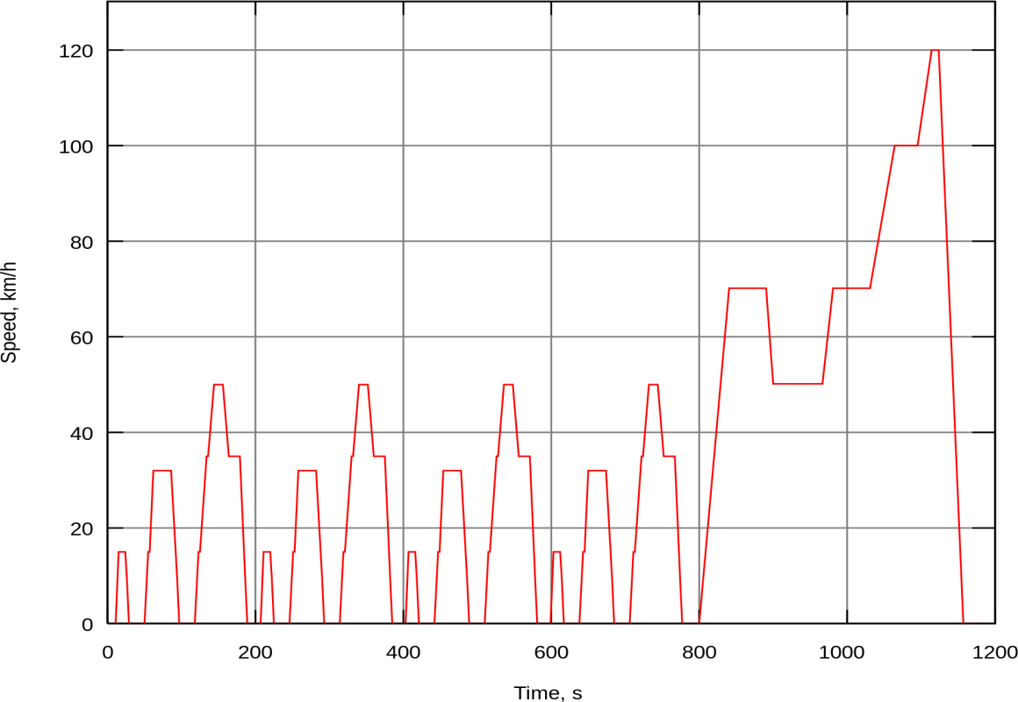
Drive cycle examples
History: NEDC
New European Drive Cycle (1970 – 2019)
WLTC from EU
accepted by China, Japan and USA

Slide 10
Driving cycles
Overview article:
https://www.car-engineer.com/the-different-driving-cycles/
EU official data:
UN-ECE WLTC class 3:
https://unece.org/DAM/trans/doc/2012/wp29grpe/WLTP-DHC-12-07e.xls
USA official data:
https://www.epa.gov/vehicle-and-fuel-emissions-testing/dynamometer-drive- schedules
E.g: FTP, HWFET, NYCC, US06
Japan:
10-Mode, 15-Mode, JC08
Other sources:
https://dieselnet.com/standards/

Slide 11
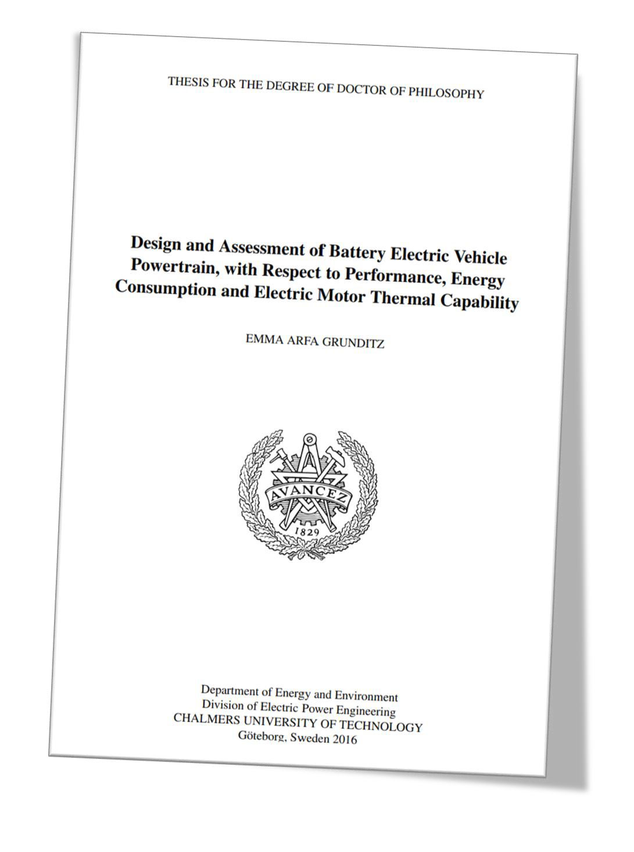
More sources
For a deep dive into how drive cycles affect dimensioning of EV powertrains, I recommend the PhD thesis:
Design and Assessment of Battery Electric Vehicle Powertrain, with Respect to Performance, Energy Consumption and Electric Motor Thermal Capability
by EMMA ARFA GRUNDITZ
Chalmers University of Technology

Slide 12
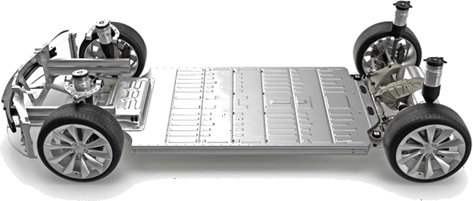
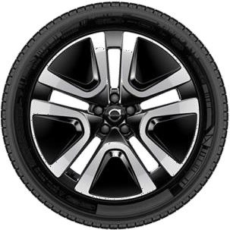
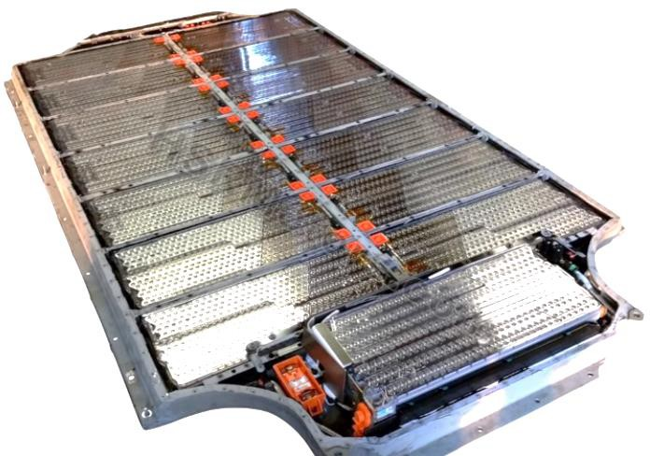
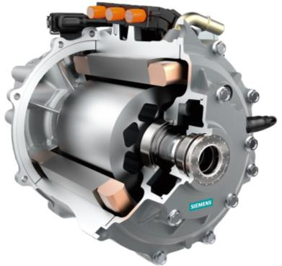
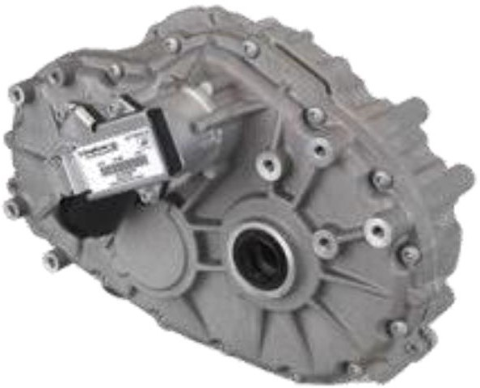
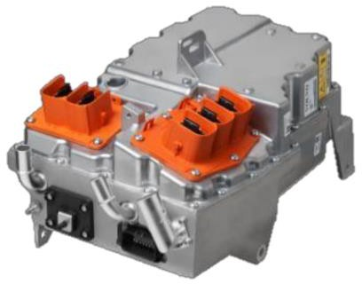
Electrical Drive Systems
Tire(s)
Image courtesy: Volvo Cars
RESS
(Battery)
PEC
(Power Electric Converter)
EM
(Electric machine)
GB + DIFF
(Gearbox & differential)
Image source: EV Tech Explained
Image courtesy: BorgWarner
Image courtesy: Siemens
Image courtesy: BorgWarner

Slide 13
Gearbox model

Slide 14
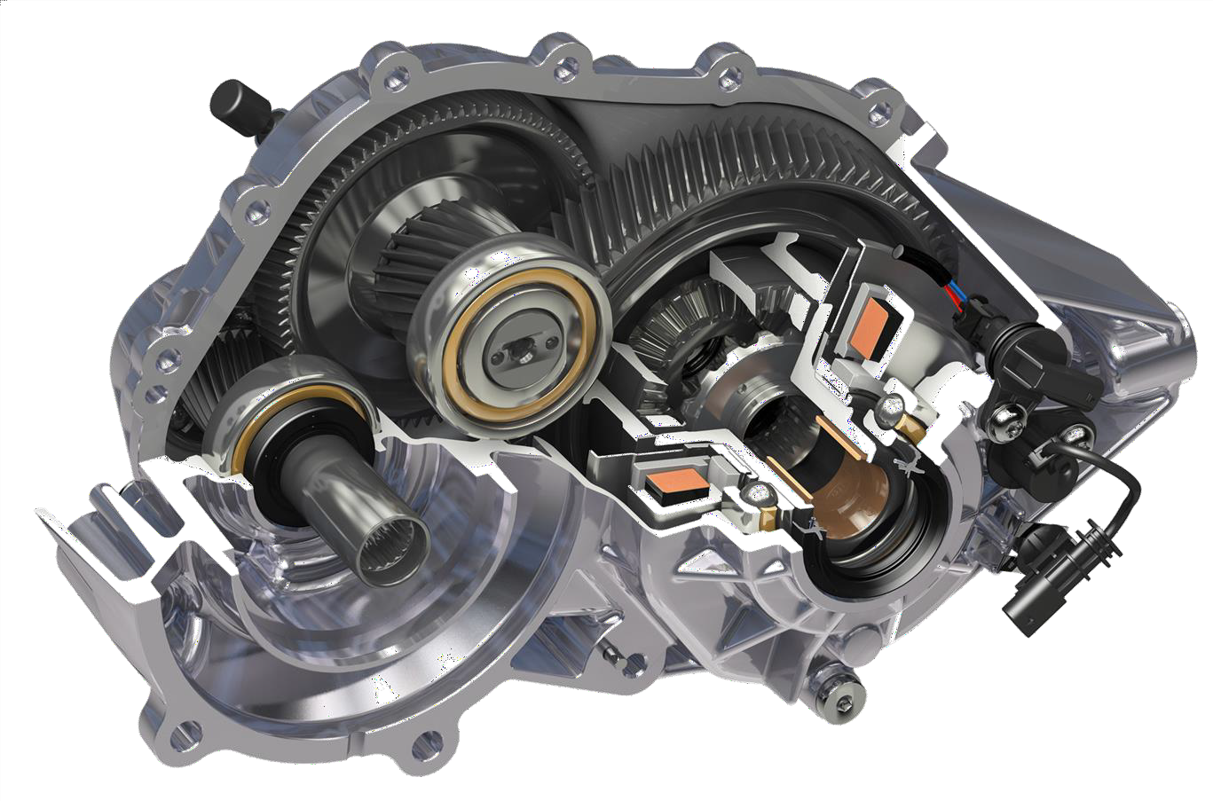
Gearbox model
Our assumption is “quasi-static”:
No transient time dynamics
For EVs, no gear changes will be needed
No clutches needed
An ideal gearbox transforms input rotational power (speed * torque) to another speed torque combination
Fixed gear ratio
Image courtesy: GKN

Slide 15
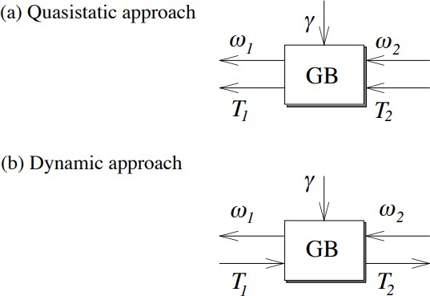
Gearbox model
Image source: Vehicle Propulsion Systems, Guzzella, Sciarretta, 2007
High speed input (e.g. Electric Machine):
𝜔₁ = Rotational speed (rad/s)
𝑇₁ = Torque (Nm)
Low speed output (e.g. differential/wheels):
𝜔₂ = Rotational speed (rad/s)
𝑇₂ = Torque (Nm)

Slide 16
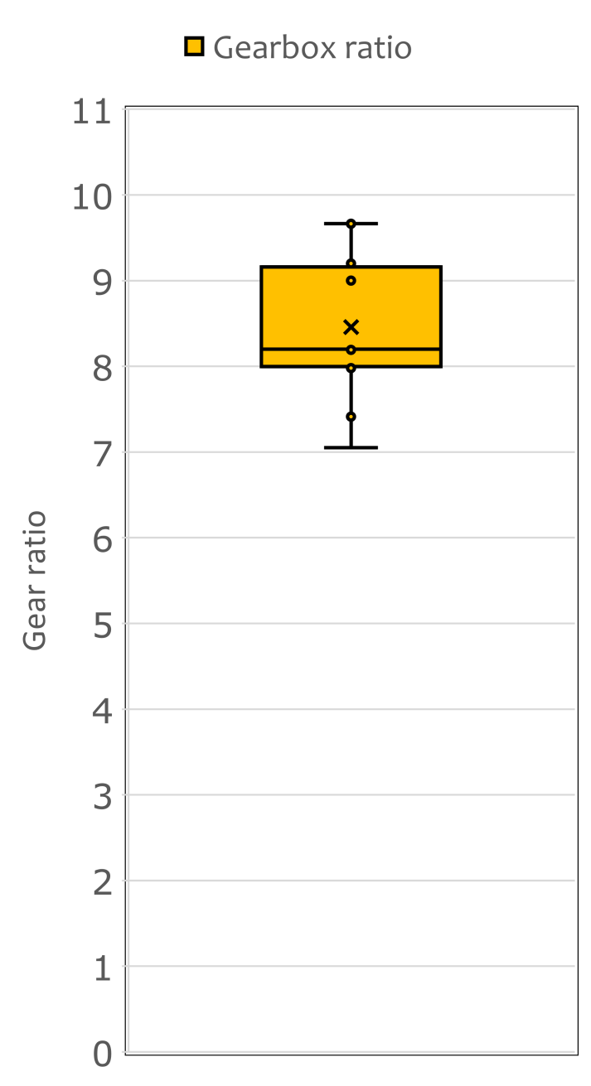
Typical gear ratios
^{Ω}𝐸𝑀
^{Ω}𝐺𝐵
Statistics from 20 common EV models in year 2020.
Ca 8.5 gear ratio is the mean

Slide 17
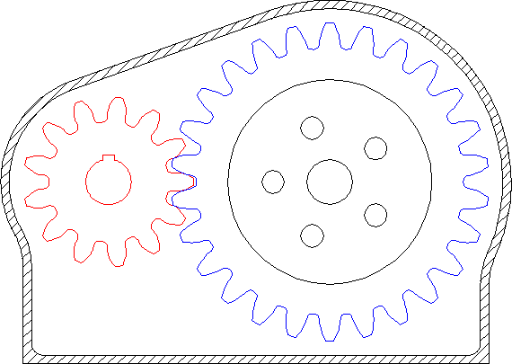
Gearbox losses
All mechanical powertrain components have losses
Rule of thumb: 1% losses per cogwheel pair interaction
Rule of thumb: Max 1:4 gear ratio per gear step
A typical EV gearbox ratios are 1:9
➔ How many gear steps are needed?
➔ What’s the resulting efficiency estimation?
A little more advanced:
Not all gear ratios can be selected; prefer “Hunting gear ratios”:
Pinion and gear teeth number have no common factor
Minimizes wear, noise and maximises lifetime of cogwheels

Slide 18

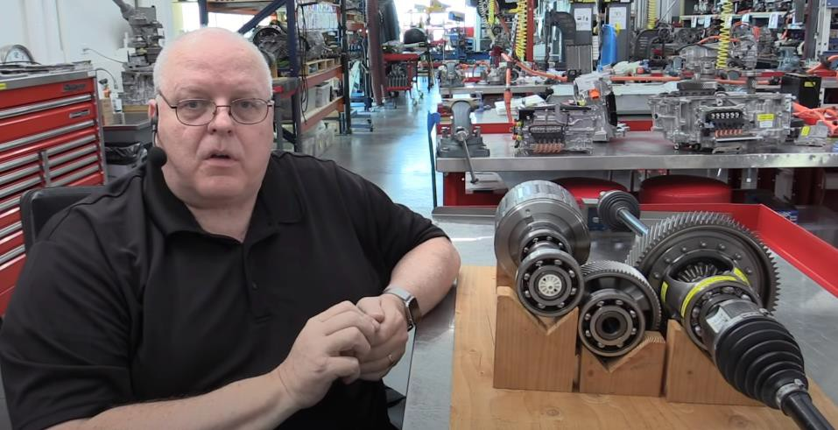
Typical EV gearbox
Professor Kelly demonstrates how most Tesla reduction gears are built. Use this video to answer some questions in Assignment 2 3.
Tesla Model 3 and Y Modular Motors
Weber Auto (Watch 0:00-13:30 min)

Slide 19


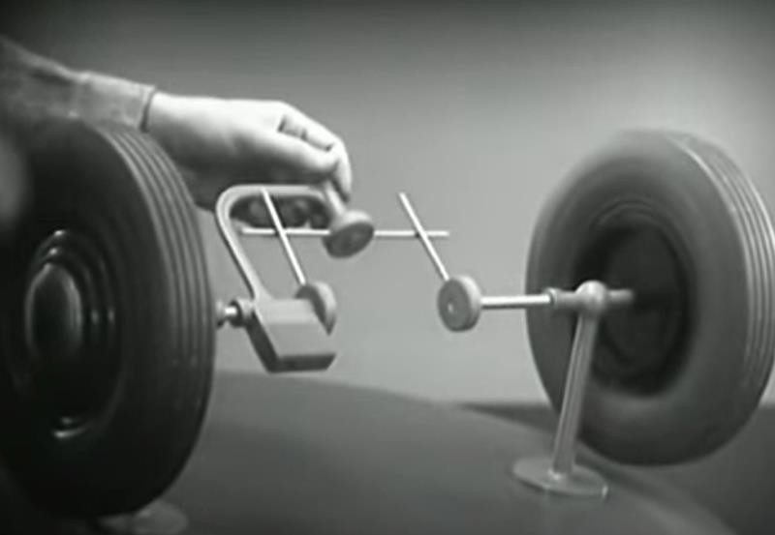
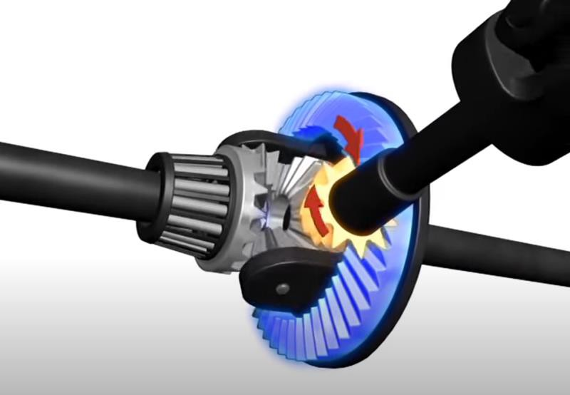
Differential – Movies for inspiration
Around The Corner –
How Differential Steering Works (1937)
https://youtu.be/yYAw79386WI
How a Differential Works and Types of Differentials https://youtu.be/gIGvhvOhLHU

Slide 20
Differential
The normal case in EVs is to have the differential integrated in the gearbox (as supposed to manty ICEs)
The reduction gear in the differential is the final gear of the gearbox!
The differential only adds losses when output speeds aren’t matched
Our vehicle model assumes only longitudinal motion:
➔No differential losses
The differential isn’t modeled since it doesn’t transform any speed,
torque or add losses while driving forward

Slide 21
Vehicle model in Simulink
Differential equations with graphical programming.

Slide 22
Vehicle model in Simulink
Working Folder, Matlab Workspace
Model, blocks, subsystems
Solver, time stepping
Init-scripts, m-files, global parameters
Plot-functions: Scope, Data Inspector and Plot from Workspace
Demo of existing Vehicle Model in Simulink
How to import, plot and use drive cycle data in Simulink

Slide 23
Assignment 2
Please find full details in Canvas “Assignments” module!

Slide 24
Car definition for assignment 2
Constants
Variables (“operating point”)
Results
𝐹_{𝑡} = Traction force needed (N)
𝑃_{𝑡}= Traction power needed (W)
𝑇_{𝑡}= Traction wheel torque (Nm)
ρ_{𝑎} | = 1.225 kg/m³ | Set by drive cycle.
𝑐_{𝑟} | = 0.009 | α = 0
𝐴_{𝑓} | = 2.3 m² | 𝑣 = Vehicle speed (m/s)
𝑐_{𝑑} | = 0.28 | 𝑎= Derived in simulation
𝑚_{𝑣} = 1 700 kg 𝑔 = 9.81 m/s² 𝑑_{𝑤} = 2𝑟_{𝑤} = 0.649 m 𝜂_{𝐺𝐵}= 0.98 𝛾_{𝐺𝐵}= 8.0

Slide 25
Assign. 2 A
Use: Links to drive cycle official data from lecture slides
You will get:
Simulink model “EDR100_Model1.slx”
Init-script for Simulink “init_Model1.m”
Example m-file for WLTC import “Drive_cycle_example.m”
Present three different drive cycles and calculate, plot graphs
One being WLTC
Plot for each drive cycle with axis labels and units:
Speed vs time in km/h
Acceleration vs time in m/s^2
Traction power in W

Slide 26
Assign. 2 B
You will get:
M-file for Assign. 1 solution ”solutions_Assignm1.m”
Sensitivity Analysis for Total Traction Power
For speeds from 0…180 km/h with steps of 10 km/h
Plot the total traction power (P_t or P_wheel)
Use solution script from Assignment 1 or Simulink
Hand in:
Plot with P_tot vs speed
Table with all 19 values in plot (0 decimals)

Slide 27
Assign. 2 C
Implement slope function in simulink model
Run model with WLTC and slope of
+0.07 rad
-0.07 rad
Plot cycle with axis labels and units:
Speed vs time in km/h
Acceleration vs time in m/s^2
Traction power in W
Provide comment of Traction power compared to assignment 2A with WLTC, what is different and why?

